Slide 1

Advanced Topics in Core Java
Santosh Kumar Kar

Slide 2

Questions
As a developer, what crucial factors should be considered to guarantee the application runs seamlessly with optimal performance, minimizing lags or crashes? This includes aspects like scalability, response time, and resource utilization?

Slide 3



Agenda
Part - 1: Memory Management in Java
Part - 2: Concurrency & Multi-thread
Part - 3: Java 8 Features
Part - 4: Reflection
Part - 5: Unit Testing & TDD
Part - 6: Design Patterns

Slide 4




Pre-Requisites
1. JVM 2. JRE 3. Class & Object 4. Anonymous class
5. Method 6. Process & Threads

Slide 5

Topic one
Memory Management in Java

Slide 6
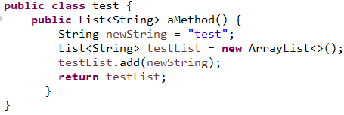
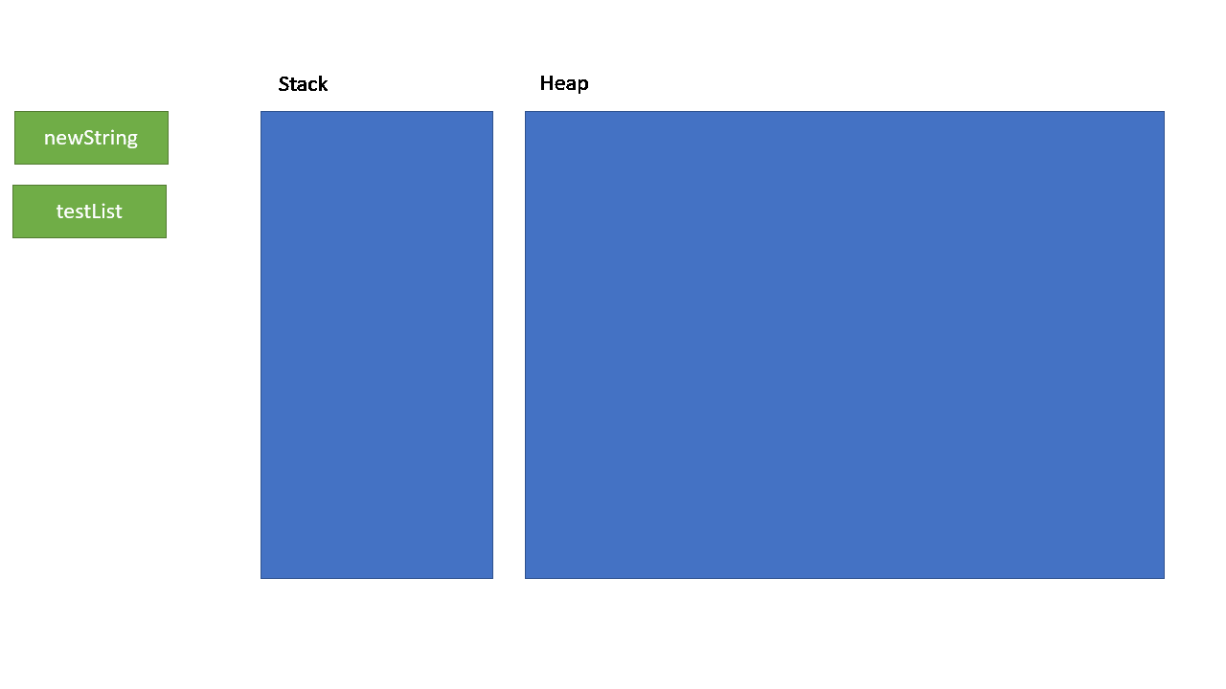

Slide 7
Available Collectors
Serial Collector
Parallel Collector
Garbage-First (G1) Garbage Collector
The Z Garbage Collector

Slide 8

Question
What Is A CPU Core? What is the difference between a single core and multi-core processor?

Slide 9
Question
What are the fundamental differences between threads and processes in software development, and how do they impact the performance and behavior of an application

Slide 10
Topic Two
Concurrency and Multithreading

Slide 11
Core & Process
A processor can have multiple cores. A core is a processing unit of the CPU
3 main parts of Core – 1) ALU 2) Set of registers & memory
A Processor can have multiple cores
A computer can have multiple Processor
Core is a physical hardware component whereas Thread is the virtual component that manages the tasks of the core.
Cores require only a single unit of processing; threads require multiple processing units for task execution.
Cores enable completion of more work at a time, while threads enhance computational speed and throughput

Slide 12
Thread & Process
Thread: A single flow of execution in a program.
Process: multiple threads can run concurrently, allowing tasks to be performed in parallel.
Threads share the same memory space and resources within a process
Can share data among threads. Process cannot

Slide 13
Threads & Java
Creating Thread
extending Thread class
Implementing Runnable interface
Using Executor Service
Runnable vs Callable
Race conditions

Slide 14
Question - 1
What is the use of interface?

Slide 15
Question - 2
What does a NullPointerException signify, and what steps can be taken to prevent it from occurring?"?

Slide 16
Question - 3
What is the difference between Comparator and Comparable? How do you implement in Java?

Slide 17
Topic Three
Java 8 Features

Slide 18
Java 8
Static and Default Methods
Lambda Expressions
Functional Interfaces
Method Reference
Streams
Comparable and Comparator
Optional Class
Date/Time API

Slide 19
Topic Four
Reflection

Slide 20
Reflection
Allows us to inspect and manipulate classes, interfaces, constructors, methods, and fields at run time.
The required classes for reflection are provided under java.lang.reflect package

Slide 21
Question
What do you understand by Testing? Who is a Tester?
Can a developer should be the tester?

Slide 22
Topic Five
Unit Testing & TDD

Slide 23
Unit Testing & TDD
Unit Testing:
A software development approach where developers write automated tests before writing the actual code.
TDD
Test Driven Development
The test is expected to fail initially
Then, the code is written to pass the test.
This process is repeated for each new feature or functionality.

Slide 24
Benefits of TDD
Early Bug Detection
Improved Code Quality
Regression Testing:
Documentation and Specification

Slide 25
JUnit
Widely used Java testing framework that allows developers to write and run automated tests for their Java code.
provides a simple and organized way to verify that code behaves as expected.
JUnit makes it efficient to test individual units of code, helping developers catch and fix bugs early in the development process.

Slide 26
Useful Methods in JUnit
Assertions:
assertEquals(expected, actual)
assertTrue(condition):
assertFalse(condition)
assertNull(object)
assertNotNull(object)
assertSame(expected, actual)
assertNotSame(expected, actual)
assertArrayEquals(expectedArray, resultArray)
Timeout and Exception Testing:
@Test(timeout = milliseconds):
@Test(expected = Exception.class)
Annotations:
@Test
@Before
@After
@BeforeClass
@AfterClass

Slide 27
Topic 6
Design Patterns

Slide 28
Design Patterns
A general, reusable solution to a commonly occurring problem within a specific context in software design.
it's a description or template for how to solve a problem that can be used in many different situations.
Design patterns are not specific to any specific programming language. They are high-level concepts and guidelines for designing software in a way that promotes maintainability, scalability, and flexibility.
The idea of design patterns originated from the field of architecture, where architects would document common design solutions to common problems. In software development, design patterns were popularized by the book "Design Patterns: Elements of Reusable Object-Oriented Software" by the "Gang of Four" (Erich Gamma, Richard Helm, Ralph Johnson, John Vlissides).

Slide 29
Design Patterns
Creational
Structural
Behavioral
Singleton
Factory
Abstract Factory
Prototype
Adapter
Composite
Proxy
Fly Weight
Façade
Bridge
Decorator
Template Method
Mediator
Chain of Responsibility
Observer
Strategy
Command
State
Visitor
Iterator
Interpreter
Memento

Slide 30

Questions?

Slide 31


Thank You
Santosh Kumar Kar
santosh.kar@braneeterprises.com

